Slide 1
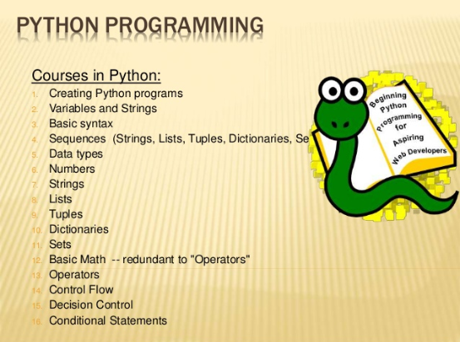
MID TERM TEST REVIEW

Slide 2
f = open('Challenge1_output.txt','w')
f.write("HELLO!")
f.write(" type aaa to end entry of team members' names")
print(" type aaa to end entry of team members' names")
while (1==1):
teammembername = input("State Team Member's Name and Student number in the form Name-StudentNumber: ")
f.write(teammembername + "\n")
print(' you entered ', teammembername )
f.close()
DESCRIBE WHAT WILL HAPPEN WHEN YOU RUN THIS CODE
ADD CODE TO THE SEGMENT ABOVE TO MAKE THE PROGRAM STOP RUNNING AT SOME POINT.

Slide 3
def codeSegment1():
presidents = ["Washington", "Adams", "Jefferson", "Madison", "Monroe", "Adams", "Jackson"]
for num, name in enumerate(presidents, start=1):
print("President {}: {}".format(num, name))
a = 4
dogs = ['Bichon Frise', 'Border Collie', 'Beagle', 'Siberia Husky']
c = 3
for x in range(1,a):
print(a, x)
for dog in dogs:
print(dog)
In the space below, write the OUTPUT OF THE PROGRAM

Slide 4
Write a program to add the first 10 integer numbers using a FOR LOOP:

Slide 5
Write a program to add the first 10 integer numbers using a WHILE LOOP:

